Slide 1

EC8811-PROJECT WORK
PREDICTIVE ANALYSIS OF AGED AND FAULTY ELECTRONIC APPLIANCES IN SMART HOME
DOMAIN-EMBEDDED/IOT
GUIDED BY TEAM MEMBERS
Dr .P.SATHEES LINGAM M.E.,Ph.D S.Krithik Gokul(811519106071)
Assistant Professor T.N.Sagar(811519106117)
ECE/KRCE B.Prasanna Venkatachalapathi
(811519106102)

Slide 2
CONTENTS
ABSTRACT
LITERATURE SURVEY
PROBLEM STATEMENT
EXISTING SYSTEM
EXISTING PROBLEM STATEMENT
PROPOSED SYSTEM
SOFTWARE REQUIREMENTS
BLOCK DIAGRAM AND EXPLANATION
SIMULATION RESULT AND CIRCUIT DIAGRAM
ADVANTAGES AND DISADVANTAGES
CONCLUSION AND REFERENCES

Slide 3
ABSTRACT
In smart home, the prediction of smart devices age as well as fault is mandatory to avoid the problems in automation and replace the expired smart devices.
The pervasiveness of home automation has been increasing greatly in recent years due to much higher affordability and simplicity to get updates through smart phone and tablet connectivity.
AI based algorithm is implemented for automation of home product system and also medicine expired detection using RFID reader process.
It is automation of the home, housework, hospital or household activity or domestic activities under the observance.
This proposed model utilizes for energy saving as well as identifying the aged smart devices and the medicines

Slide 4
LITERATURE SURVEY

Slide 5
S.NO | TITLE | AUTHOR & YEAR | DESCRIPTION
1. | Predictive Analytics of Energy Usage by IoT-Based Smart Home Appliances for Green Urban Development | Mohammad Shorfuzzaman , M. Shamim Hossain 2021 | Green IoT primarily focuses on increasing IoT sustainability by reducing the large amount of energy required by IoT devices. Whether increasing the efficiency of these devices or conserving energy, predictive analytics is the cornerstone for creating value and insight from large IoT data.
2. | A Comprehensive Predictive-Learning Framework for Optimal Scheduling and Control of Smart Home Appliances Based on User and Appliance Classification | Wafa Shafqat , Kyu-Tae Lee 2022 | Machine learning has shown significant outcomes in the field of energy management systems. This paper presents a comprehensive predictive-learning based framework for smart home energy management systems.

Slide 6
3. | Smart Homes and Quality of Life for the Elderly: Perspective of Competing Models | DEBAJYOTI PAL , TUUL TRIYASON 2018 | this paper is to fill up this void of a lack of theoretical approach by testing the three models in the context of the adoption of smart homes by the elderly population. In order to do so, we conducted a survey with and analyzed the results using the structural equation modeling and confirmatory factor analysis techniques.
4. | Factors Significantly Impacting Consumer Acceptance of Entertainment, Domestic, and Housekeeping Smart Home IoT Devices | Shalini Chopra,Nasar Al Siyabi 2022 | Smart Home devices are more popular suggesting that there is variance in acceptance of IoT devices. This research investigates the differences in consumer acceptance of various Smart Home device categories. Smart Home devices were categorised
5. | Using RFID Technology for Managing Patient Medical File | Mohammad Mizanur Rahman 2018 | Radio Frequency Identification (RFID) technology usingradio frequencies for identifying objects in inventory, tracingcars in parking areas and identifying books in libraries. RFIDtechnology also can be used in hospital medical record formanaging patient medical Files. RFID is a very populartechnology for identifying an item or object from nearestdistance.

Slide 7
PROBLEM STATEMENT
The main problem of Smart home automation we need to analysis the product life time of the system
The medicine are the main of all the person. In this system identify the medicine expired date.
Aging based product analysis is important problem for predict the life time Smart home appliance
Many product in Smart home appliance have fault in the system

Slide 8
EXISTING SYSTEM
In existing system energy level of home appliance based sheme employed in existing system for monitoring for home appliances .
IOT based home appliances monitoring scheme has been implemented in existing system .

Slide 9
EXISTING PROBLEM STATEMENT
The main drawback of the existing system we can able monitor analysis the product quality
We cant able to predict the life time of the product
It’s the main drawback of the product quality analysis

Slide 10
PROPOSED SYSTEM
The necessity is to have some past activities of the user from day to day life and in some cases, machine learning would not have reference past values for prediction. In that case, prediction would not be possible for some of first few days. After long year, the prediction would possible for identify the old appliances.
The proposed system predictive analysis of the Smart home appliances scheme is proposed for monitoring the Smart home application monitoring
The proposed system predictive analysis of the Smart medicine expired is proposed for monitoring and intimated.
The life and energy of prediction of product is predicted based IOT scheme proposed here
This will be used for monitor and analysis the product quality of the system.

Slide 11
SOFTWARE REQUIREMENTS
MC Programming Language :Embedded C
Coding : Arduino IDE 1.8.3
Simulation :PROTEUS

Slide 12
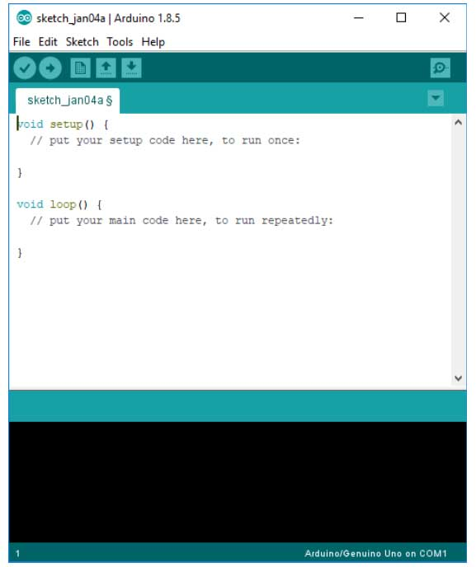
ARDUINO IDE
The Arduino integrated development environment (IDE) is a cross-platform application (for Windows, macOS, Linux) that is written in the programming language Java. It is used to write and upload programs to Arduino board.
Arduino is an open-source electronics platform based on easy-to-use hardware and software. Arduino boards are able to read inputs - light on a sensor, a finger on a button, or a Twitter message - and turn it into an output - activating a motor, turning on an LED, publishing something online. You can tell your board what to do by sending a set of instructions to the microcontroller on the board

Slide 13
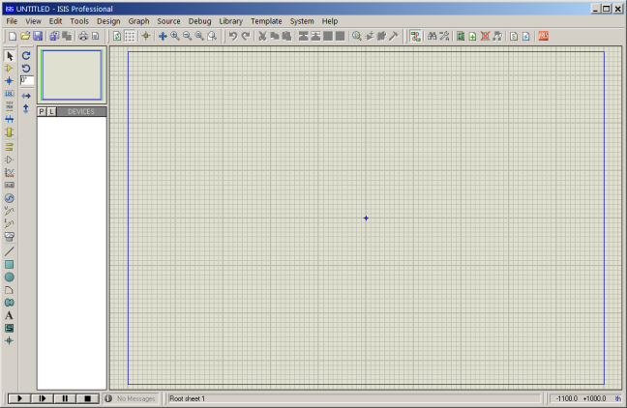
PROTEUS
Proteus is a simulation and design software tool developed by Labcenter Electronics for Electrical and Electronic circuit design.
Proteus's simulation feature. Many of the components in Proteus can be simulated. There are two options for simulating: Run simulator and advance frame by frame.
The "Run simulator" option simulates the circuit in a normal speed (If the circuit is not heavy). "Advance frame by frame" option advances to next frame and waits till you click this button for the next time. This can be useful for debugging digital circuits.

Slide 14
BLOCK DIAGRAM
Power supply
cloud
TEMPERATURE SENSOR
ATMEGA 328 Micro Controller
IOT
VOLTAGE SENSOR
CURRENT SENSOR
LCD
BUZZER
RFID READER

Slide 15
HARDWARE BLOCK DIAGRAM EXPLANATION
The hardware explanation of product, to calculating product temperature,voltage,and current values through ATmega328P microcontroller comment.
The temperature sensor value above than 40 to intimate the LCD and IOT on electronics appliances production fault.
The current sensor value increased particular stage to intimate on LCD and IOT on on electronics appliances production fault.
The voltage sensor value above than 230V to intimate the LCD and IOT on electronics appliances production fault.
The microcontroller comment and control on all the components. The RFID reader is used to the medicine expired detection to intimate the IOT and LCD.
The all sensors values are update to the IOT. The IOT main advantage is the all the information viewed on anywhere. If any sensors are damaged to intimate the IOT through network. So watch on anywhere.

Slide 16
SOFTWARE BLOCK DIAGRAM
Database collection
Of Microcontroller
Processing of think speak web server
View on HTML Page
Home Appliances Aged display

Slide 17
SOFTWARE BLOCK DIAGRAM EXPLANATION
The software process are start to the hardware measure of products output result.
Such us, temperature, current and voltage all the database values are store the microcontroller.
The microcontroller save and command on all the components. The all the informations are viewed on the think speaker web server through HTML page to identifying the home appliances age.

Slide 18
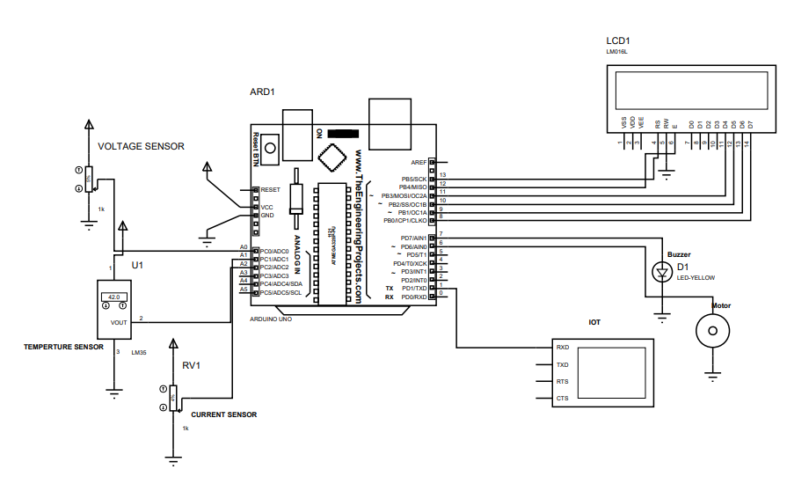
CIRCUIT DIAGRAM

Slide 19
BLOCK DIAGRAM
cloud
Temperature
IOT
Product
1
(new or
Old)
Current
Voltage
Temperature
IOT Product
2
(new or
Old)
Current
Voltage

Slide 20
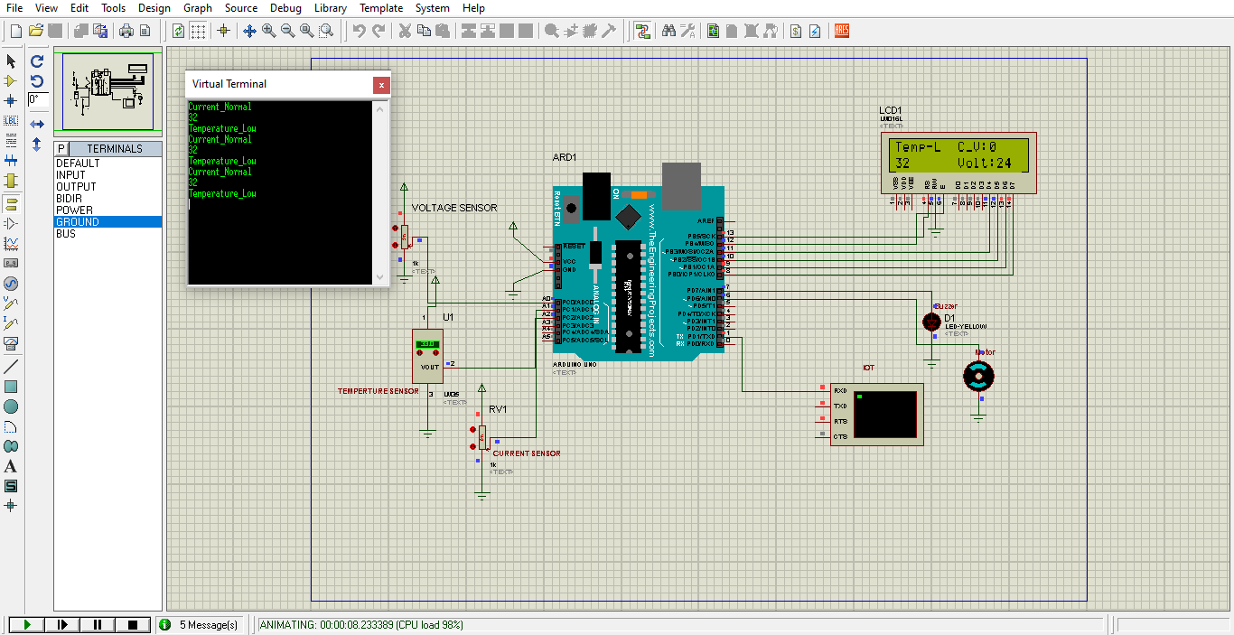
SIMULATION RESULT

Slide 21


Slide 22
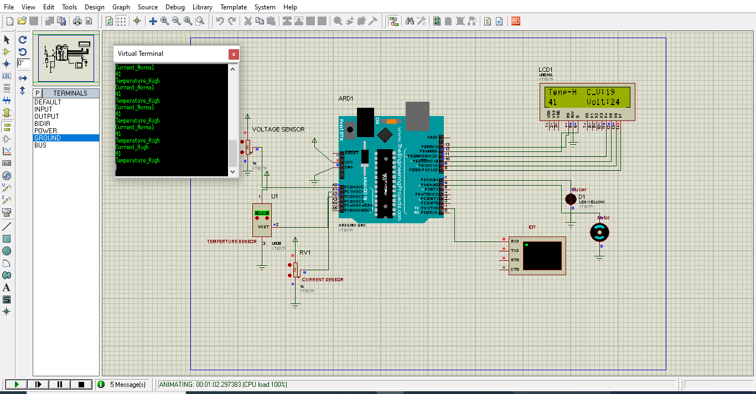

Slide 23
ADVANTAGES
It is important to explore the aged users.
The gauge the intention of the users.

Slide 24
DISADVANTAGES
High Cost.
In the unpredictability of the surrounding environment which adds unwarranted risks of interrupted monitoring services.

Slide 25
CONCLUSION
Primarily smart homes and related technologies consist of various kinds of sensors, appliances, and monitoring systems that are connected together and act like an automated system enabling both localized and remote control of the environment . The type of sensors, control appliances, and devices that are installed depend upon the application type and nature of support provided. They range from hot water systems, lighting for homes, fridges, TVs to sensors and equipment that are used for the purpose of health monitoring . Smart home services are considered one of the most promising potential markets as the demand for related products has increased exponentially over the past few years.
In my project, we provide the results for energy consumption predictions when we include the scheduling module in our proposed methodology. For every user, we see a noticeable drop in the energy consumption and the energy cost when we include each module of the proposed methodology and apply proper control rules.

Slide 26
REFERENCE
Yadav, A.K.S.; Sora, M. An optimized deep neural network-based financial statement fraud detection in text mining. 3c Empres. Investig. Y Pensam. Crítico 2021, 10, 77–105. [CrossRef]
Luo, H.; Hu, X.; Zou, Y.; Jing, X.; Song, C.; Ni, Q. Research on a reference signal optimisation algorithm for indoor Bluetooth positioning. Appl. Math. Nonlinear Sci. 2021, 6, 525–534. [CrossRef]
Ramesh, J.; Al-Ali, A.R.; Al Nabulsi, A.; Osman, A.; Shaaban, M. Deep Learning Approach for Smart Home Appliances Monitoring and Classification. In Proceedings of the 2022 IEEE International Conference on Consumer Electronics (ICCE), Las Vegas, NV, USA, 7–9 January 2022; pp. 1–5.
Rashid, R.A.; Chin, L.; Sarijari, M.A.; Sudirman, R.; Ide, T. Machine learning for smart energy monitoring of home appliances using IoT. In Proceedings of the 2019 Eleventh International Conference on Ubiquitous and Future Networks (ICUFN), Zagreb, Croatia, 2–5 July 2019; pp. 66–71.
. Veloso, A.F.d.S.; de Oliveira, R.G.; Rodrigues, A.A.; Rabelo, R.A.; Rodrigues, J.J. Cognitive smart plugs for signature identification of residential home appliance load using machine learning: From theory to practice. In Proceedings of the 2019 IEEE International Conference on Communications Workshops (ICC Workshops), Shanghai, China, 20–24 May 2019; pp. 1–6.

Slide 27


